Slide 1


District Counselor Meeting
Inspire
Inspire
November 30, 2023

Slide 2


Title here
Please sit at the appropriate table
Table | School Group
1 | CHS
2 | EHS
3 | JHS
4 | SHS, MAE & JAE
5 | EIS & SLE
6 | EVG & LOE
7 | GMS & FVE
8 | HEA & CWE
9 | NMS
10 | PCE & EME
11 | WHE, GAE & HAE
12 | JFE, MCE & MOE
13 | SFE, WOE, VRE & TCE

Slide 3
Title here
QUICK UPDATES
Counseling Intern Opportunities
Clarification About Forms in “StudentCrisisSupport” Folders
January Counselor Meeting
College Board Accommodations | Due to Lindsey by 12/15

Slide 4
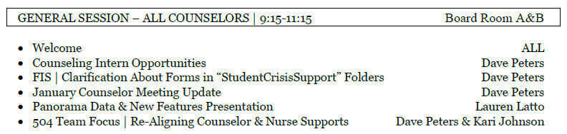
Title here
TODAY’S AGENDA

Slide 5


Title here

Slide 6

…Where our priority is always the kids!
6

Slide 7


Title here
SECTION 504

Slide 8

Title here
SECTION 504

Slide 9
Title here
A NEEDED ADJUSTMENT
There has been some confusion introduced by the use of terms that incorrectly imply that there are “medical 504’s” and “academic 504’s”
In Everett Public Schools, we are going to change our practice to refer to them simply as “504’s”

Slide 10
Title here
THE KEY QUESTIONS…
When does a counselor manage a student 504 and when does a nurse serve in that role?
How do I develop/write accommodations for things that are outside of my wheelhouse?

Slide 11



Title here
TYPES OF ACCOMMODATIONS

Slide 12
Title here
TYPES OF ACCOMMODATIONS

Slide 13

Title here
TYPES OF ACCOMMODATIONS

Slide 14
Title here
TYPES OF ACCOMMODATIONS

Slide 15

Title here
TYPES OF ACCOMMODATIONS

Slide 16
Title here
THE KEY QUESTIONS…
When does a counselor manage a student 504 and when does a nurse serve in that role?
If I’m managing a 504 process, how do I develop/write accommodations for things that are outside of my wheelhouse?

Slide 17
Title here
WHAT IS…
The role of the “manager”…
  Gather information for eligibility considerations
  Schedule & run the 504 team meeting(s)
  Ensure 504 process steps are followed
  Ensure all forms are complete and submitted / uploaded to Special Programs
  Put the plan in action by communicating with teachers and others who need to know

Slide 18


Title here
WHO TAKES POINT?
Nurse-Managed
  Diabetes
  Anaphylaxis
  Asthma
--------------------------------
Counselor serves as consultant for the development & wording
of academic-related accommodations

Slide 19



Title here
A NEEDED ADJUSTMENT
Counselor-Managed
  All other scenarios
  ---------------------------------
  Nurse serves as consultant for the development & wording of medical-related accommodations

Slide 20
Title here
HEALTH PLAN & 504’s
What are key differences between a “health plan” and a “504 plan”?
Do all 504’s need an accompanying health plan?
Do all health plans need an accompanying 504 plan?

Slide 21

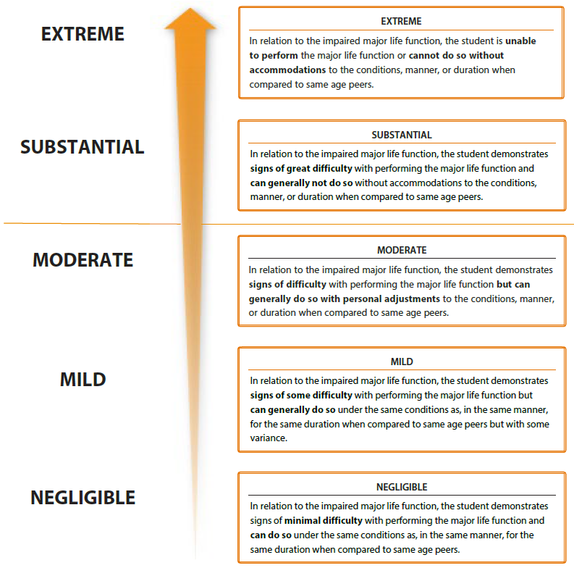
Title here
504 ELIGIBILITY
Substantial Impairment Determination

Slide 22
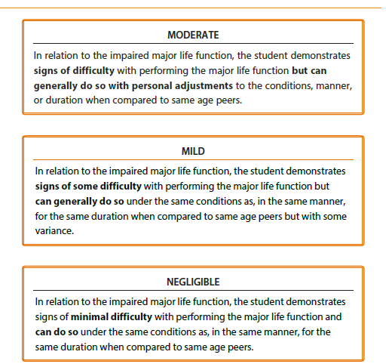
Title here
504 ELIGIBILITY
Impact Below Threshold

Slide 23

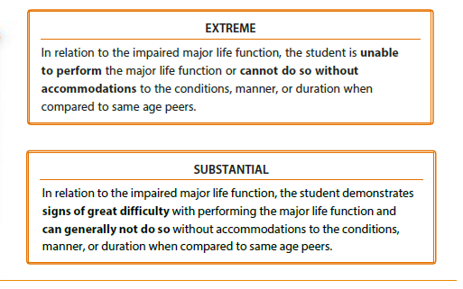
Title here
504 ELIGIBILITY
Impact Above Threshold

Slide 24
Title here
PROCESS POINTS TO PONDER
SCENARIO
During a conversation, a parent explains to you that they believe their student needs a 504 plan.
How might you respond, and what are some appropriate steps to take?

Slide 25
Title here
PROCESS POINTS TO PONDER
APPROPRIATE STEPS
Ask questions to gauge their understanding the purpose of a 504
Help fill in any gaps in understanding if/as needed
  To determine whether the student has an impairment that substantially limits one or more major life activities
  And if so, to provide accommodations so that the student can access and benefit from their education

Slide 26
Title here
PROCESS POINTS TO PONDER
APPROPRIATE STEPS
Explain the parts of the 504 process
  Request a referral for evaluation
    Provide them a 504-3 form
  Provide consent for an evaluation
    Provide them a 504-4 form
  The school team evaluates
    Although Section 504 does not give parents/guardians the right to participate in a 504 meeting, EPS considers this best practice whenever possible/appropriate.
  If eligible, the team creates a 504 plan
  The school puts the plan in action
  The school reviews and evaluates the plan

Slide 27
Title here
PROCESS POINTS TO PONDER
APPROPRIATE STEPS
After receiving a submitted 504-3 form – or when adequate information is available – determine appropriate manager to organize/communicate
    NURSE * - Diabetes, Anaphylaxis, Asthma
    COUNSELOR * - All other scenarios
  *unless mutually agreed otherwise in the best interest of the student

Slide 28
Title here
PROCESS POINTS TO PONDER
WHAT NOT TO DO
Avoid sharing your initial speculations about whether the student will/won’t qualify for a 504. In other words, don’t inadvertently hold an informal evaluation meeting.
  Remember, you need consent to evaluate
  Determination is a team decision, not individual

Slide 29
Title here
LET’S DO SOME ROLE PLAYS
Hypothetical Scenario
The team is meeting to determine if a student is eligible for a 504 plan.
For the sake of this role play, here’s what you know:
The student has a broken bone
Is the student eligible for a 504 plan? Explain your thinking as a table group.

Slide 30
Title here
LET’S DO SOME ROLE PLAYS
Hypothetical Scenario
The team is meeting to determine if a student is eligible for a 504 plan.
For the sake of this role play, here’s what you know:
The student has a broken wrist
Is the student eligible for a 504 plan? How does this additional information influence your thinking?

Slide 31
Title here
LET’S DO SOME ROLE PLAYS
Hypothetical Scenario
The team is meeting to determine if a student is eligible for a 504 plan.
For the sake of this role play, here’s what you know:
The student has a broken left wrist – and they are right hand dominant
Is the student eligible for a 504 plan? How does this additional information influence your thinking?

Slide 32
Title here
LET’S DO SOME ROLE PLAYS
Hypothetical Scenario
The team is meeting to determine if a student is eligible for a 504 plan.
For the sake of this role play, here’s what you know:
The student has a broken right wrist – and they are right hand dominant
Is the student eligible for a 504 plan? How does this additional information influence your thinking?

Slide 33
Title here
OUTCOMES
Important Takeaways
Do we have enough information to conclude eligibility using the following 3 questions (see 504-5)
Does the student have a physical or mental impairment?
If so, does the impairment substantially limit one or more major life activities?
If so, are there accommodations, aids, and/or services that the student needs in order to access and benefit from their education?

Slide 34

Title here
Q & A TIME
“Clear is kind.” - Brené Brown
What questions do you have that would benefit from further clarity?
Thank you!

